Slide 1
Automatic Deception Detection in Spoken Dialogue
Nishi Cestero
Notes:
Responding to request from DHS for Mmodal and empirically verified approachs to deception detection since it is well known to the intelligence community that polygraphs and humans perform at chance. Now AFOSR’s Trust and Influence Program.

Slide 2
Collaborators
Sarah Ita Levitan
Julia Hirschberg
Michelle Levine
Guozhen An (CUNY)
Andrew Rosenberg (CUNY, now Google)
Gideon Mendels
Rivka Levitan
Xi Chen
Kara Schechtman
Angel Maredia
Jessica Xiang
Bingyan Hu
William Wang
James Shin
Yocheved Levitan
Mandi Wang
Kai-Zhan Lee
Zoe Baker-Peng
Ivy Chen
Meredith Cox
Leighanne Hsu
Yvonne Missry
Gauri Narayan
Molly Scott
Jennifer Senior
Grace Ulinksi
Mukund Yelahanka Raghuprasad

Slide 3
Deceptive Speech
Deliberate choice to mislead
Without prior notification
To gain some advantage or to avoid some penalty
Deception does not include:
Self-deception, delusion, pathological behavior
Theater
Falsehoods due to ignorance/error
Notes:
Our definition of deception

Slide 4
Humans are very poor at Recognizing Deception Cues (Aamodt & Mitchell 2004 Meta-Study)
Group | #Studies | #Subjects | Accuracy %
Criminals | 1 | 52 | 65.40
Secret service | 1 | 34 | 64.12
Psychologists | 4 | 508 | 61.56
Judges | 2 | 194 | 59.01
Cops | 8 | 511 | 55.16
Federal officers | 4 | 341 | 54.54
Students | 122 | 8,876 | 54.20
Detectives | 5 | 341 | 51.16
Parole officers | 1 | 32 | 40.42
Notes:
K is # of studies and N is number of participants
Note that people with legal responsibilities are the worst at detecting deception, criminals are best and parole officers worst.
But ”normal” people with no legal background judge deception no better than chance…

Slide 5
Don’t we have a lie detector (polygraph) ?
‘Automatic’ methods (e.g. polygraph)
Human training
Behavioral Analysis: Interview/Interrogation methods
No empirical support, ex. :
Truth: I didn’t take the money vs. Lie: I did not take the money
(what about non-native speakers?)
Laboratory studies
(facial expression, body posture/gesture, brain activation, odor,…)
Notes:
J. Bachenko, E. Fitzpatrick, and M. Schonwetter, “Verification and implementation of language-based deception indicators in civil and criminal narratives,” in Proceedings of the 22nd Interna- tional Conference on Computational Linguistics-Volume 1. As- sociation for Computational Linguistics, 2008, pp. 41–48.
[2] T. Fornaciari and M. Poesio, “Automatic deception detection in italian court cases,” Artificial intelligence and law, vol. 21, no. 3, pp. 303–340, 2013.
[3] V.Pe ́rez-Rosas,M.Abouelenien,R.Mihalcea,Y.Xiao,C.Linton, and M. Burzo, “Verbal and nonverbal clues for real-life deception detection.” in EMNLP, 2015, pp. 2336–2346.
[4] M. Ott, Y. Choi, C. Cardie, and J. T. Hancock, “Finding deceptive opinion spam by any stretch of the imagination,” in Proceedings of the 49th Annual Meeting of the Association for Computational Linguistics: Human Language Technologies-Volume 1. Associ- ation for Computational Linguistics, 2011, pp. 309–319.
[5] M. L. Newman, J. W. Pennebaker, D. S. Berry, and J. M. Richards, “Lying words: Predicting deception from linguistic styles,” Per- sonality and social psychology bulletin, vol. 29, no. 5, pp. 665– 675, 2003.
[6] J. Hirschberg, S. Benus, J. M. Brenier, F. Enos, S. Friedman, S. Gilman, C. Girand, M. Graciarena, A. Kathol, L. Michaelis et al., “Distinguishing deceptive from non-deceptive speech.” in Interspeech, 2005, pp. 1833–1836.
Nemesysco develops vocal lie-detectors, emotion-detectors and love-detectors
claims to have built detectors based on vocal cues
Universal Lie Response
Anders Eriksson and Francisco La Cerda’s article "Charlatanry in forensic speech science: A problem to be taken seriously."
In the 2007 peer-reviewed academic article "Charlatanry in forensic speech science", the authors reviewed 50 years of lie detector research and came to the conclusion that there is no scientific evidence supporting that voice analysis lie detectors actually work.[8] Lie detector manufacturer Nemesysco threatened to sue the academic publisher for libel resulting in removal of the article from online databases. In a letter to the publisher, Nemesysco's lawyers wrote that the authors of the article could be sued for defamation if they wrote on the subject again.[9] [10] The full text of the article is available online.[11]

Slide 6
Goals
Identify spoken language cues to deception
Extract acoustic-prosodic, and lexical cues automatically
Examine individual differences: Take gender, ethnicity, culture, and personality factors into account as features in classification
Use Machine Learning techniques to train models to classify deceptive vs. non-deceptive speech, which can help humans identify subtle deceptive cues humans may miss: Collaborative AI.
Notes:
*controlled experiments

Slide 7
Columbia Cross-Cultural Deception Corpus (CXD)
Include
Gender and personality information for all subjects
Compare subjects with different cultural and language backgrounds
CXD: Pair native speakers of SAE with native speakers of Mandarin Chinese, all speaking English, interviewing each other

Slide 8
Columbia X-Cultural Deception Corpus
340 subjects, balanced by gender and native language (American English, Mandarin Chinese): 122 hours of speech
Crowdsourced transcription, automatic speech alignment (hand-corrected)
Notes:
Largest corpus of cleanly-recorded deceptive/non-deceptive speech
IPU: phrases separated by 50ms or more
Turns: consecutive speech from one speaker with only backchannels from the other
Q/A: first answer to one of the 24 questions
Q/A+follow-up: interviewee responses to first Q and follow-up Qs

Slide 9
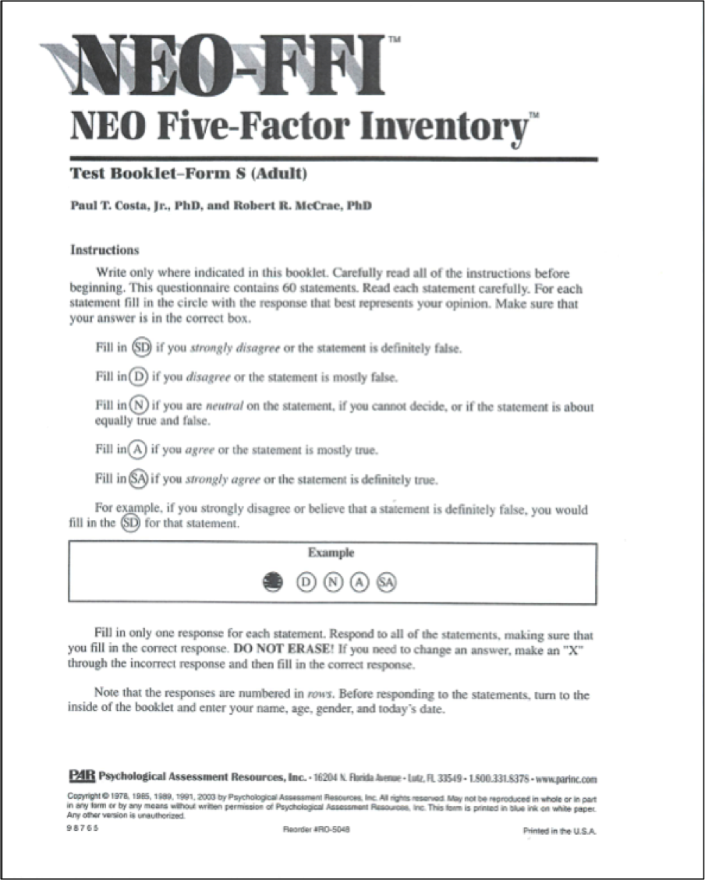
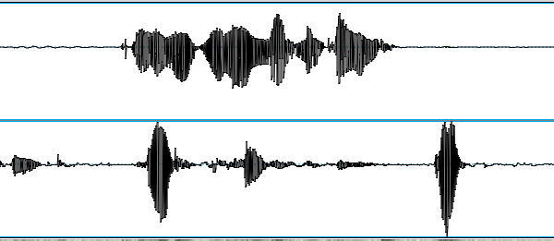
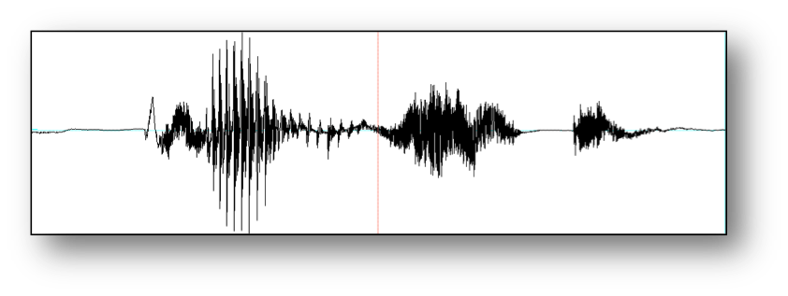
Our CXD Experiment
NEO-FFI
Survey
Background
survey
Lying game
Biographical
Questionnaire
Baseline sample

Slide 10
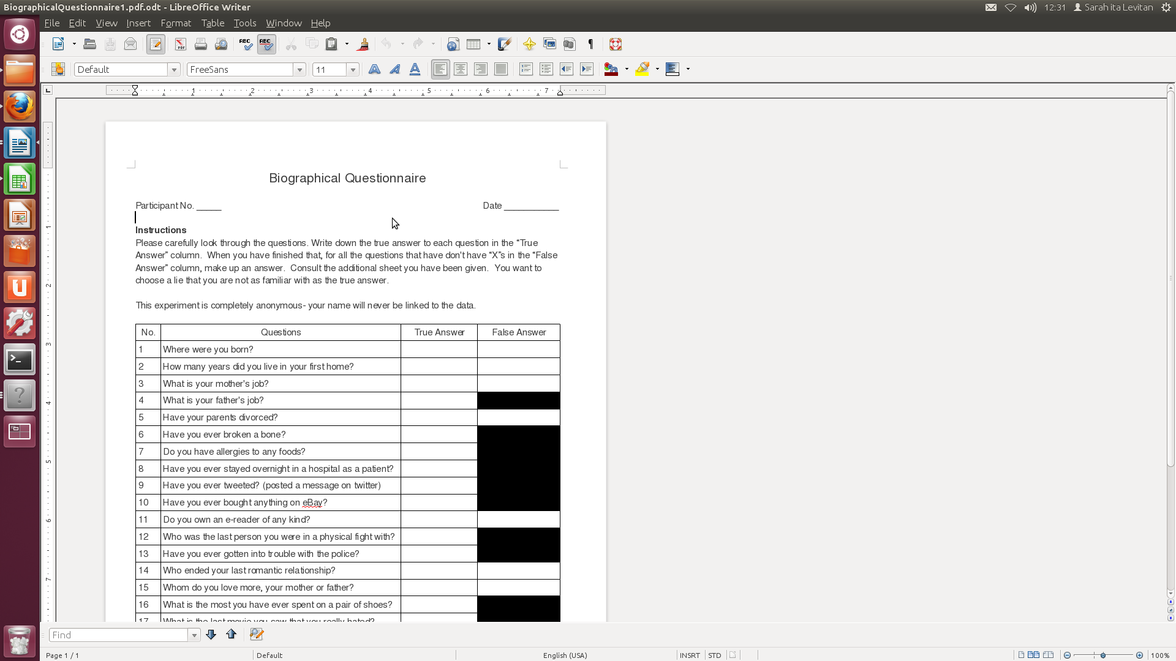
Biographical Questionnaire
Notes:
Also balanced for question type:
half yes/no and half wh-questions
half sensitive:
Who was the last person you had a physical fight with? Who do you love more, you mother or your father? Who broke off your last romantic relationship? Did you ever cheat on a test in high school.
and half not sensitive
Where were you born? Have you ever broken a bone? Have you ever tweeted.
Make up reasonable lies about random half
Balance between yes/no and whq’s; between sensitive and non-sensitive

Slide 11
The Big Five NEO-FFI (Costa & McCrae, 1992)
Openness to Experience: “I have a lot of intellectual curiosity.”
Conscientiousness: “I strive for excellence in everything I do.”
Extraversion: “I like to have a lot of people around me.”
Neuroticism: “I often feel inferior to others.”
Agreeableness: “I would rather cooperate with others than compete with them.”
Notes:
Costa & McCrae (1992) NEO-FFI Personality Measures and sample questions
Openness to Experience: intellect/imagination, originality, curiosity, ingenuity, imaginative, insightful “I have a lot of intellectual curiosity.”
Conscientiousness: orderliness, responsibility, dependability, organized, thorough, planful
“I strive for excellence in everything I do.”
Extraversion: talkativeness, assertiveness, energy “I like to have a lot of people around me.”
Neuroticism: anxiety, emotional instability, intense, moody, “I often feel inferior to others.”
Agreeableness: good-naturedness, cooperativeness, sympathetic, kind, affectionate, trust “I would rather cooperate with others than compete with them.”

Slide 12
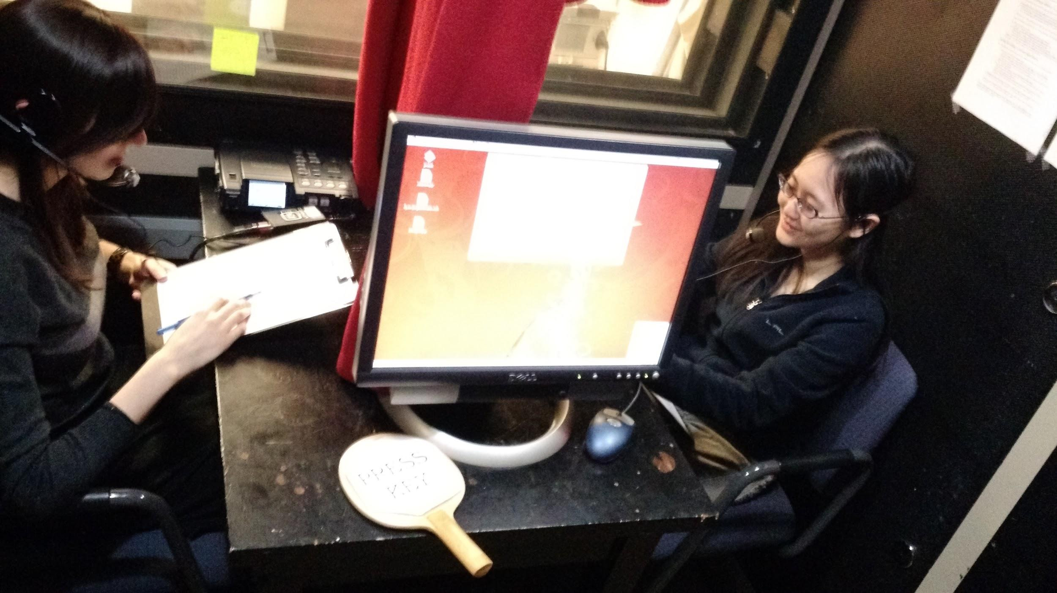
Experimental Soundbooth Setup
Notes:
One subject interviews the other on the 24 questions, scoring truth or lie for every answer. Interviewee tries to convince the interviewer they are telling the truth on every question. Then they change places and start again.

Slide 13
Motivation and Scoring
Monetary motivation
Success for interviewer:
Add $1 for every correct judgment, truth or lie
Lose $1 for every incorrect judgement
Success for interviewee:
Add $1 for every lie interviewer thinks is true
Lose $1 for every lie interviewers thinks is a lie
Good liars tell the truth as much as possible when lying, so how do we know what’s true or false for follow-up questions?
Interviewees press T/F keys after every phrase
Notes:
Interviewer motivation: We didn’t want interviewees to try to sound like they were lying, only to sound truthful.

Slide 14
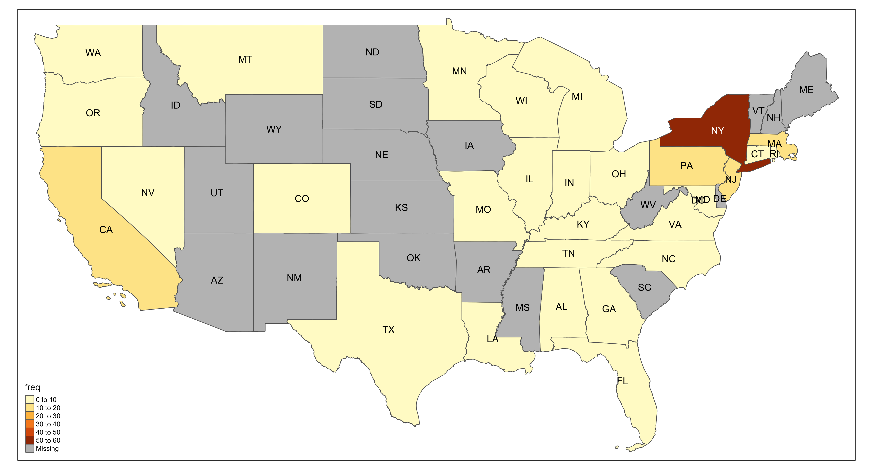
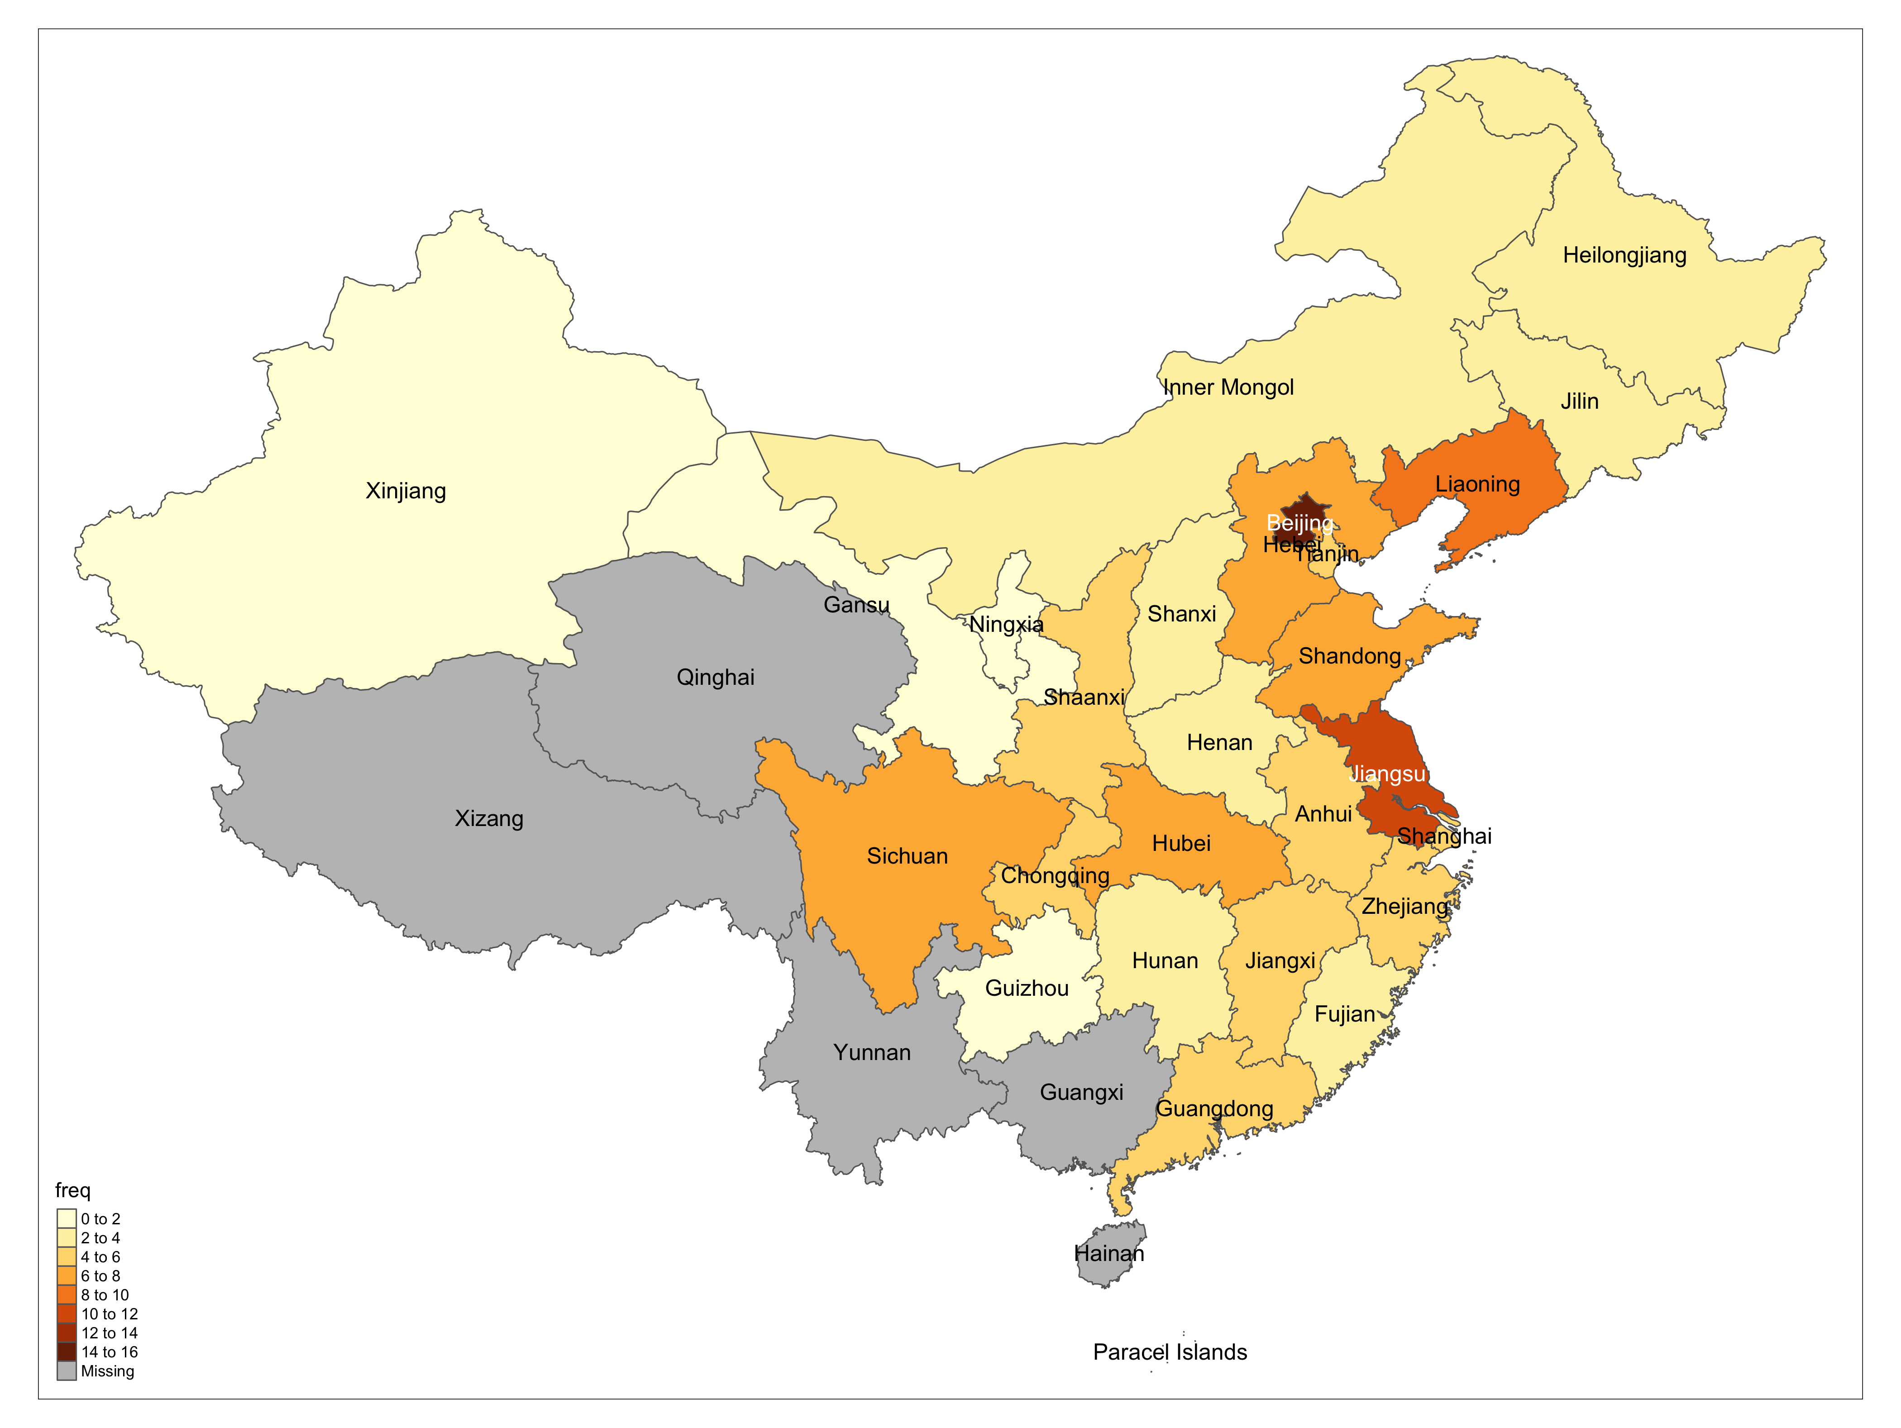
Where do our speakers come from?
Notes:
For the U.S. we’ll group states using Bill Labov’s regional dialect groups (Labov, 2012) and how North American English has become more
diverse over the years due in part to political forces. Interestingly, the forensic linguist Roger Shuy can identify where the Unabomber was raised,
where he had moved to, how old he was, how educated, and what religion he was raised in – all from the text of his letters.
Shuy read the letters and Manifesto and said: Unabomber was not, as many thought, a poorly educated young man, but was actually:
In his 50s
Highly educated, with an advanced degree,
--and the degree was not in the humanities
Had lived in, but was not from, the American West
but had been raised in Chicago in the Midwest
Had been raised a Catholic

Slide 15
Code Sample : Geospatial Visualization
demographic_maps.R script used libraries rnaturalearth, tmap to produce both static and interactive map widgets to visualize geographical origins of speakers recruited in experiment.
Reads demographic data from CSV file
Aggregates counts of speakers from USA and China.
ne_states(…) : Retrieves SpatialDataFrame object for use in drawing maps.
append_data(…) : Joins map object with our aggregate counts by state or province name.
tm <- tm_shape(china_map) + tm_polygons("freq", id="name")+ tm_text(“name") : draws a static map, stores in tm variable
saveWidget( tmap_leaflet(tm ), “… .html” ) : saves an interactive web version of the map.

Slide 16
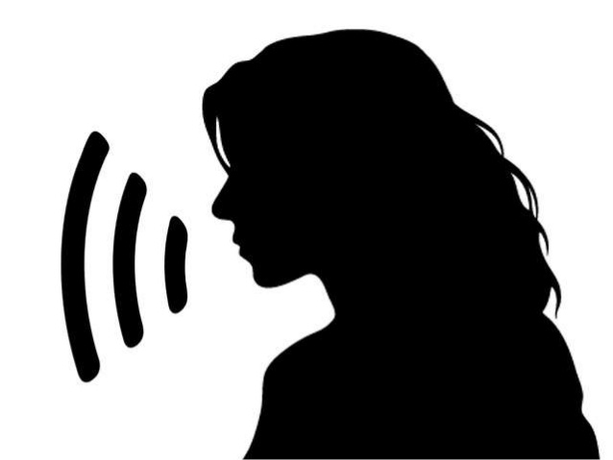

“Did you ever cheat on a test in high school?”
TRUE or FALSE?
Notes:
And now for a final test…
True. P406p407-part1
Judged true by human.

Slide 17

“Did you ever cheat on a test in high school?”

Slide 18
“Did you ever cheat on a test in high school?”
TRUE or FALSE?
Notes:
Turn this
False. P482p483-part1
Judged true by human.

Slide 19

“Did you ever cheat on a test in high school?”
Notes:
False. P482p483-part1

Slide 20
“Where were you born?”
True or False?
Notes:
Now a chance to try out your lie detection skills:
“I was born in Oakland California, but… I moved to LA like a few years, when I was like in third grade… or right before third grade.”

Slide 21
“Where were you born?”
Notes:
“I was born in Oakland California, but… I moved to LA like a few years, when I was like in third grade… or right before third grade.”

Slide 22
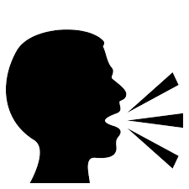
“What is the most you have ever spent on a pair of shoes?”
True or False?
Notes:
False.p376p377-part2

Slide 23
“What is the most you have ever spent on a pair of shoes?”
Notes:
False.p376p377-part2

Slide 24
Features Extracted
Text-based: n-grams, psycholinguistic: Linguistic Inquiry and Word Count (LIWC) (Pennybaker et al), other linguistic deception indicators
Speech-based: Pitch, intensity, speaking rate, voice quality, etc. (386)
Gender, native language, NEO-FFIs personality scores and clusters
Syntactic features (complexity)
Notes:
Psycholinguistic features from practitioner literature
Word embeddings: capture semantic similarity of use by context

Slide 25
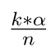
Analysis of Deceptive Speech Cues
Automatically extract features from
Text transcript: word counts, pauses, laughter, syntax (complexity),…
Speech audio: Pitch, intensity, speaking rate, voice quality, …
Normalize features per speaker
Perform t-tests to compare feature means over all speakers, then divided by native language, gender, and personality.
ex. Do lies contain more filled pauses (“umm”s) than truthful responses?
Correct for Type I error, α=0.05. k^{th} p sig <
Notes:
So adding personality helps significantly with deception prediction: it appears that speakers with different personality traits lie or tell the truth somewhat differently.
So not we want to know, do speakers differ by gender or by native language as well?
As a start, we compare distributions of features characterizing lies and truth over the whole corpus and then over different gender and language groups.
We also examine whether interviewer belief that a response is true or not varies both by the gender and native language of the speaker and of the hearer.
Correcting for family-wise Type 1 error: incorrect rejection of the true null hypothesis (aka false positive results often due to running many statistical tests on the same corpus). To correct you use the following formula to get the corrected p value:
The formula to estimate the familywise error rate is: FWE ≤ 1 – (1 – α_{IT})^{c} Where:
α_{IT} = alpha level for an individual test (e.g. .05),
c = Number of comparisons.

Slide 26
Acoustic-prosodic characteristics (8)
Pitch max
Pitch mean
Intensity max
Intensity mean
Speaking rate
Jitter
Shimmer
NHR

Slide 27
Linguistic Deception Indicators (LDI) (28)
hasAbsolutelyReally
hasContraction
hasI
hasWe
hasYes
hasNAposT
hasNo
hasNot
isJustYes
isJustNo
noYesOrNo
specificDenial
thirdPersonPronouns
hasFalseStart
hasFilledPause
numFilledPauses
hasCuePhrase
numCuePhrases
hasHedgePhrase
numHedgePhrases
hasLaugh
numLaugh
DAL.wc
DAL.pleasant
DAL.activate
DAL.imagery
specScores

Slide 28
Linguistic Inquiry and Word Count (LIWC) (93)
Adj
Adverb
Affect
Affiliation
Analytic
Apostro
Article
Assent
Authentic
Auxverb
Bio
Clout
Cogproc
Compare
Conj
Dic
Differ
Drives
Family
Focuspast
Focuspres
Function
I
Informal
Insight
Ipron
Negate
Netspeak
Nonflu
Number
Posemo
Ppron
Prep
Pronoun
Relative
Sixltr
Social
Space
tentat
Time
Tone
Verb
WC
Work
WPS

Slide 29
Complexity (23)
W words
VP verb phrase
C clauses
T t-units
DC dep. clause
CT complex t-unit
CP coordinate phrase
CN complex nominal
MLS mean length sentence
MLT mean length t-unit
MLC mean length clause
C.S clauses/sentence
VP.T verb phrases/t-unit
C.T clauses/t-unit
DC.C dep clauses/clause
DC.T dep clauses/t-unit
T.S t-units/sentence
CT.T complex t-units/t-unit
CP.T coord phrases/t-unit
CP.C coord phrases/clause
CN.T complex nom/t-unit
CN.C complex nom/clause

Slide 30
Summary: acoustic-prosodic and linguistic characteristics of deception and truth
Deception
Increased pitch & intensity max
Poor speech planning
Descriptive, detailed
Complex
Hedge
Truth
Negation
Cue phrases
Cognitive process
Function words

Slide 31
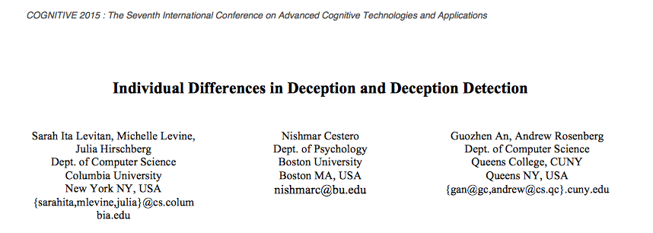
Do deception indicators vary across gender, native language, and personality?
Findings featured in ‘Best Paper’ at COGNITIVE 2015

Slide 32
Summary: speaker differences
When lying…
Male speakers increased pitch mean, had more false starts, used more past-tense words, increased the complexity of their answers.
Female speakers increased intensity mean.
Native Mandarin speakers increased false starts and affirmative words.
Native English speakers increased intensity mean, hedge phrases, third person pronouns, laughing, disfluencies.
Higher Neuroticism personalities resulted in increased max intensity and complexity.

Slide 33
Code Sample: Deception Classification
Can we train a classifier to accurately discriminate lies from truth given question responses?
Classifiers:
Random Forest
SVMs
Logistic Regression
Naive Bayes
Feature sets:
Acoustic
Lexical
Syntactic
Any combination of the above

Slide 34
Run deception_classification.py script with desired arguments
python3 deception_classification.py --seg question_chunk --features acoustic --clf lr --k 200 --sensitivity false --qnum false --interactions false --individual false --out classifier_test.csv
Main() function calls upon:
get_features_from_set (…) : compiles a list of features out of the possible sets, prints
using the following features: ['IS09', 'praat15']
load_features(…) : opens pickled (compressed) dictionary of requested features
read_folds (…): reads and returns 10 splits of the data for use in cross-validation, ensures no repetition in sampling
get_folds_features(…): returns nested list of 10 pair values (features, fold_labels)
features = matrix, size= num_segments x num_features
(761, 399)
fold_labels = vector of size= num_segments with truth values

Slide 35
select_features(folds_features, k) : select best k features
selecting 200 best features
(200,)
cross_validation(…) : perform classification, print progress, return metrics
->training model - 10 fold cross validation
(7011, 200)
(6989, 200)
(6984, 200)
(6998, 200)
(7009, 200)
(6991, 200)
(6976, 200)
(7006, 200)
(6993, 200)
(6991, 200)
acc 58.180476815 0.0151654869003
precision_f 57.9414258147 0.0145717182755
precision_t 58.4406538217 0.0160008723263
recall_f 59.6980945175 0.0183864165976
recall_t 56.6619035292 0.0178898000533
f1_f 58.8012746247 0.0155186524581
f1_t 57.5317353818 0.0159611604482
avg_p 58.1910398182 0.0152059538407
avg_r 58.1799990233 0.0151700327284
avg_f 58.1665050032 0.0151576130228
write_results(…): outputs results to CSV file

Slide 36
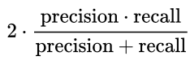
How Do Our Classifiers Compare to Humans?
Best Method : 69.81% accuracy
Classifier: Naïve Bayes
Features: lexical + syntactic
k: 5000
Corpus Baseline: 50.00 (balanced)
Human vs. ML Performance:
Accuracy: 56.75%/ 69.81%
F1: 46.50% / 69.80% ( F1= )
Recall: Humans are poor at recognizing deception cues— law enforcement agents correctly identify truthfulness at most 64.12% (Aamodt & Mitchell 2004 Meta-Study)
Notes:
Comparing humans to a RF classifier trained on OpenSmile, gender and native language predicting first response to each of 24 questions

Slide 37
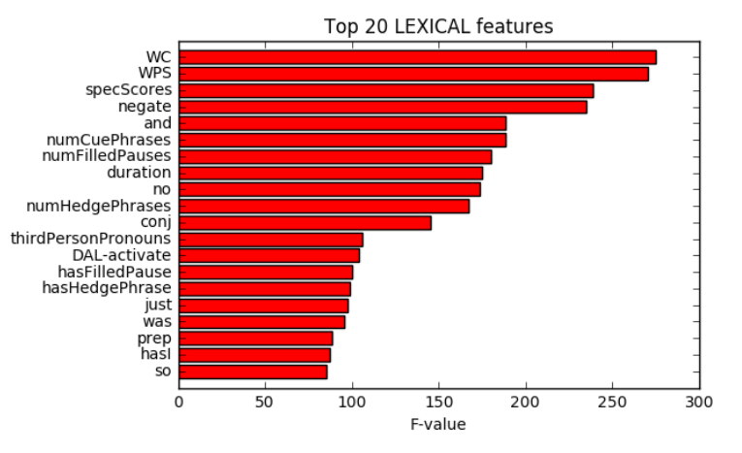
How Is the Classifier Making its Decisions?

Slide 38
When are Machines Better (or Worse) than Humans?
Are particular question types more difficult to judge than others?
Does this differ for humans and machines?
Notes:
Are there some things humans do better? And vice versa…

Slide 39
Findings
No correlation between humans and classifiers in which speakers are easy or difficult to judge – here classifiers and humans differ
No difference between humans and classifiers in judging gender or native language groups although classifier much better at judging speakers who scored low in Conscientiousness (NEO-FFI)
Both humans and classifiers judged longer responses as lies and shorter ones as truthful and both found most of the same questions easy or hard to judge

Slide 40
Some “Easy” Questions for Both
Question #5: Have your parents divorced?
Question #13: Have you ever gotten into trouble with the police?
Question # 16: What is the most you have ever spent on a pair of shoes?
What makes these easier to classify?

Slide 41
Some “Easy” Questions for Both
Question #5: Have your parents divorced?
Question #13: Have you ever gotten into trouble with the police?
Question # 16: What is the most you have ever spent on a pair of shoes?
What makes these easier to classify?
~80% of interviewee parents were not divorced
~80% of interviewees had never gotten into trouble with the police
Most spent on pair of shoes: median(T)=$150; median(F)=$350
Notes:
Lack of experience for interviewees – but also interviewers.

Slide 42
A Hard Question for Both
Question #8: Have you ever stayed overnight in the hospital as a patient?
Human_{F1}: 50 F1 (-6.37 from mean)
Classifier_{F1}: 64.59 F1 (-5.22 from mean)
What makes this harder to classify?

Slide 43
A Hard Question for Both
Question #8: Have you ever stayed overnight in the hospital as a patient?
Human_{F1}: 50 F1 (-6.37 from mean)
CLassifier_{F1}: 64.59 F1 (-5.22 from mean)
What makes this harder to classify?
~60% of interviewees never stayed overnight in the hospital as a patient
Notes:
Which means that the same number of interviewers had no such experience…

Slide 44
Hard for Humans, Easy for Classifier
Question #6: Have you ever broken a bone?
Human_{F1}: 51.55 F1 (-4.82 from mean)
Classifier_{F1}: 72.61 F1 (+2.85 from mean)
What percentage of interviewees do you think had ever broken a bone?

Slide 45
Hard for Humans, Easy for Classfiers
Question #6: Have you ever broken a bone?
Human_{F1}: 51.55 F1 (-4.82 from mean)
Machine_{F1}: 72.61 F1 (+2.85 from mean)
What percentage of interviewees do you think had ever broken a bone?
~75% had never broken a bone
Notes:
Which means that the same number of interviewers had no such experience…but neither had the classifier

Slide 46
Sensitive questions are easier for humans
Sensitive (8) vs. non-sensitive (16) questions
Sensitive: related to money, parental or romantic relationships, mortality, socially undesirable behaviors or experiences (Tourangeau & Yan, 2007)
e.g. “Who ended your last romantic relationship?” “Who do love more, your mother or your father?”
Humans were significantly better at judging sensitive questions than non-sensitive, while Classifiers showed no differences across question types

Slide 47
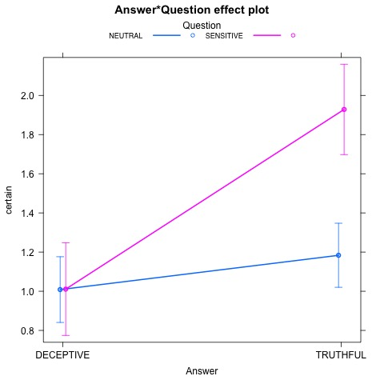
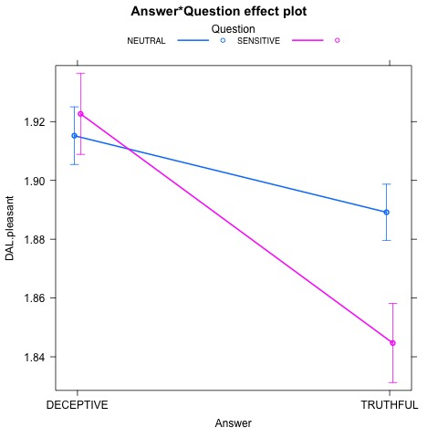
Yet another dimension introduced to deception detection…
Tendency for truthful responses to sensitive questions to differ more from deceptive responses than do truthful responses to neutral questions.
Possibly facilitates truth discrimination for human judges.

Slide 48
Code Sample: Question Sensitivity Analysis
sensitive_write_features.R :
Main body calls parse_files(…) for each of our feature sets {lexical, acoustic,…} and segmentation {single answer, answer chunk}
parse_files(segmentation, feature set) : through regular expressions, exploit file naming convention to construct output file with participant id, question number, question sensitivity, truth label, and features in set.

Slide 49
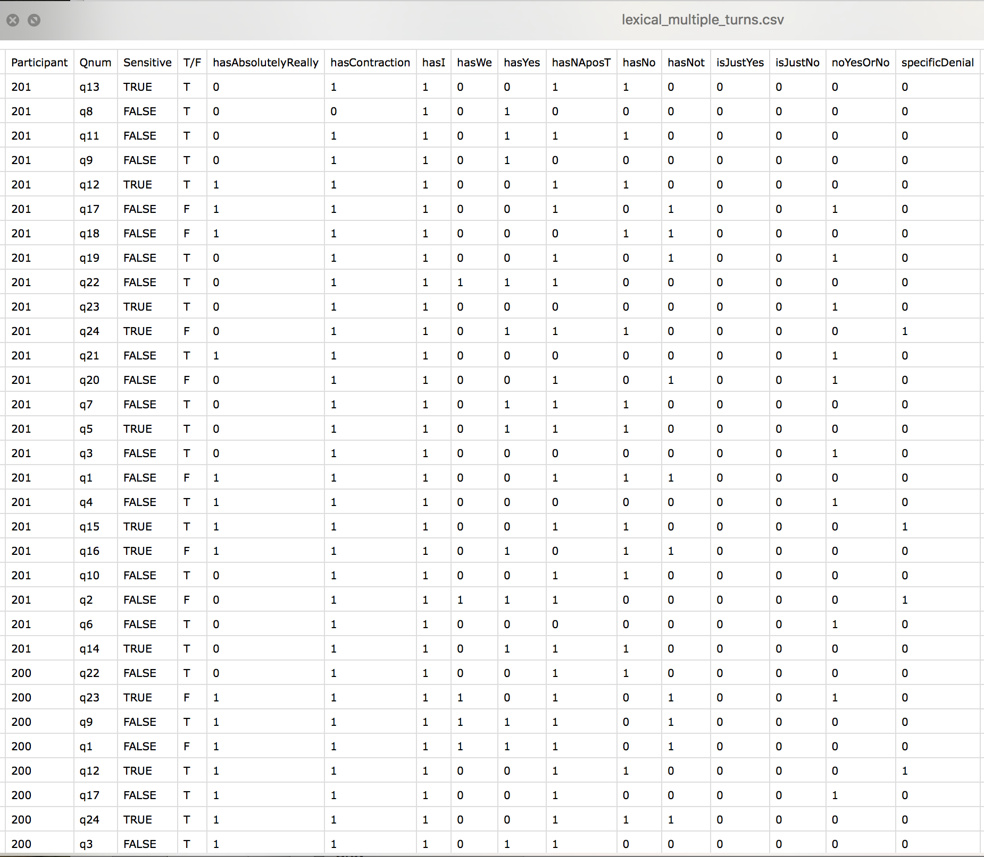
…

Slide 50
sensitive_feature_analysis.R :
Performs a series of MANOVA and posthoc tests to identify interactions between features sets (complexity, acoustic, lexical, psycholinguistic) and question sensitivity.
For each feature set and segmentation, calls:
manova_posthoc(…) : reads in appropriate file as dataframe, performs some necessary reformatting, correct for Type I error, when result significant output effect plot, write results to csv file.

Slide 51
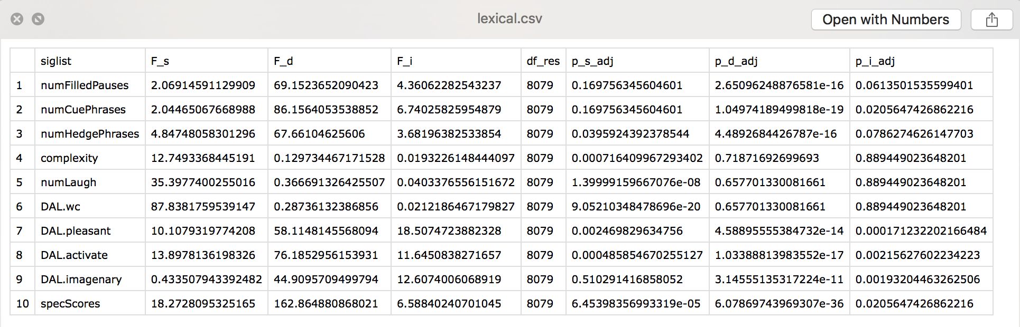
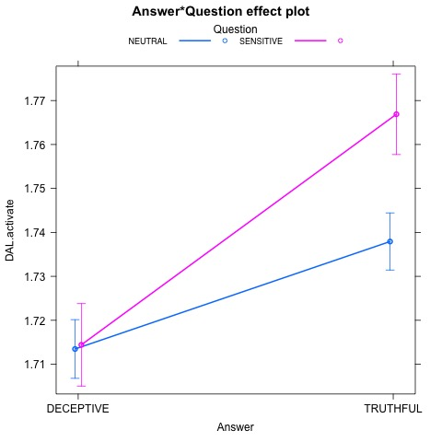

Slide 52
Future Research
Creating “trusted” and “mistrusted” synthetic voices based on our findings (What are the acoustic-prosodic features of voices that hearers believe or do not believe?) for robots, avatars, chatbots
Obtain more human judgments on our data through crowd-sourcing: The Lying Game
Notes:
And now, to test what you’ve learned ☺

Slide 53



Thank you!
All materials on Github

Slide 54
“Who was the last person you had a physical fight with?”
True or False?
Notes:
p352p353-part2_ch2/1834.867900/1840.947900/q12/n1/T

Slide 55
“Who was the last person you had a physical fight with?”
Notes:
True: p352p353-part2_ch2/1834.867900/1840.947900/q12/n1/T

Slide 56
“Who was the last person you had a physical fight with?”
True or False?
Notes:
p514p515-part2_ch2/1199.310584/1216.842950/q12/n1/F

Slide 57
“Who was the last person you had a physical fight with?”
Notes:
p514p515-part2_ch2/1199.310584/1216.842950/q12/n1/F

Slide 58
“Have you ever tweeted?”
TRUE or FALSE?

Slide 59
“Have you ever tweeted?”
Notes:
false

Slide 60
“Who was the last person you had a physical fight with?”
True or False?
Notes:
True: p372p373-part2_ch2/1053.631440/1054.731440/q12/n1/T

Slide 61
“Who was the last person you had a physical fight with?”
Notes:
True: p372p373-part2_ch2/1053.631440/1054.731440/q12/n1/T

Slide 62
“Who was the last person you had a physical fight with?”
True or False?
Notes:
False: p542p543-part2_ch2/310.619791/322.302834/q12/n1/F

Slide 63
“Who was the last person you had a physical fight with?”
Notes:
False: p542p543-part2_ch2/310.619791/322.302834/q12/n1/F

